Slide 1
Knowledge Representation
Contents
Issues in Knowledge Representation
AI Representational Systems
Semantic Networks
Scripts
Frames
Conceptual Graphs
Artificial Intelligence

Slide 2
Issues in Knowledge Representation
Representation Issues
  Generality and specificity
  Definitions, exception, default
  Causality, uncertainty
  Times
  Scheme and medium
Representation Schemes
  Scheme – data/knowledge structure
  Semantic network
  Conceptual dependencies
  Scripts
  Frames
  Stochastic methods
  Connectionist (neural networks)
Implementation media
  Medium – implementation languages
  Prolog, Lisp, Scheme, even C and Java
Artificial Intelligence

Slide 3
Semantics of Calculus
Predicate calculus representation
  Formal representation languages
  Sound and complete inference rules
  Truth-preserving operations
Meaning – semantics
  Logical implication is a relationship between truth values: p→q
Associationist theory
  Attach semantics to logical symbols and operators
Artificial Intelligence

Slide 4
Semantic Networks
Definition
  Represent knowledge as a graph
  Nodes correspond to facts or concepts
  Arcs correspond to relations or associations between concepts
  Nodes and arcs are labeled
Properties
  Labeled arcs and links
  Inference is to find a path between nodes
  Implement inheritance
  Variations – conceptual graphs
Artificial Intelligence

Slide 5
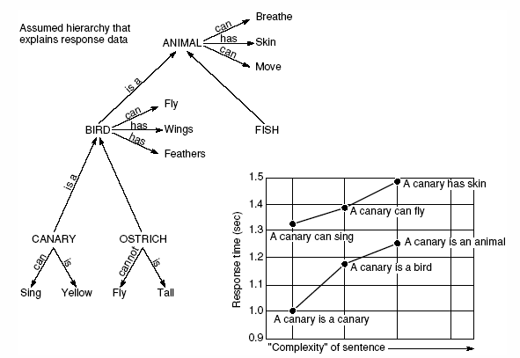
A Semantic Network on Human Information Storage and Response Times
Different inferences with given questions
Artificial Intelligence

Slide 6
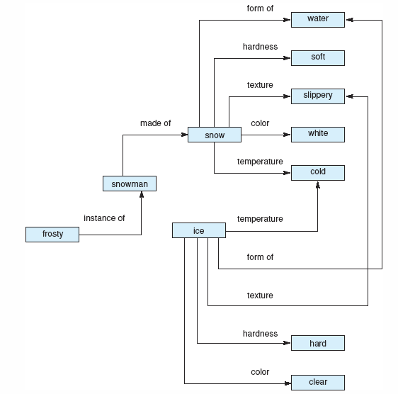
A Semantic Network Representation of Properties of Snow and Ice
Artificial Intelligence

Slide 7
Semantic Network in Natural Language Understanding
First implementation of semantic networks in machine translation
Quillian’s semantic network
  Influential program
  Define English words in a dictionary-like, but no basic axioms
  Each definition leads to other definitions in an unstructured and sometimes circular fashion
  When look up a word, traverse the network
Artificial Intelligence

Slide 8
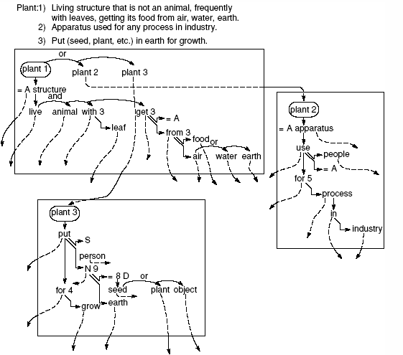
Three planes representing three definitions of the word “plant”
Artificial Intelligence

Slide 9
Inferences in Semantic Networks
Inference along associational links
Find relationships between pairs of words
  Search graphs outward from each word in a breath-first fashion
  Search for a common concept or intersection node
  The path between the two given words passing by this intersection node is the relationship being looked for
Artificial Intelligence

Slide 10
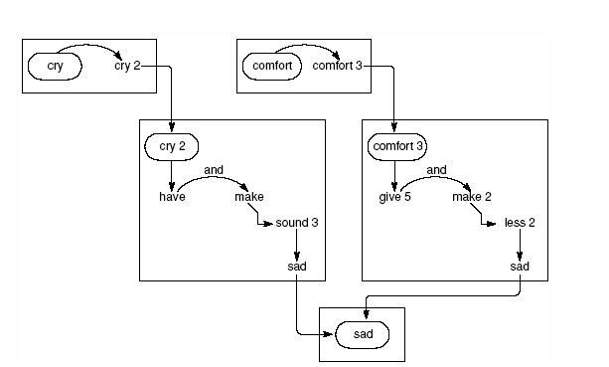
Find the relationship (intersection path) between “cry” and “comfort”
Artificial Intelligence

Slide 11
Standardized Relationships
Standardized links’ labels
Define a rich set of labels
Domain knowledge to capture the deep semantic structure
Case structure of English verbs
Artificial Intelligence

Slide 12
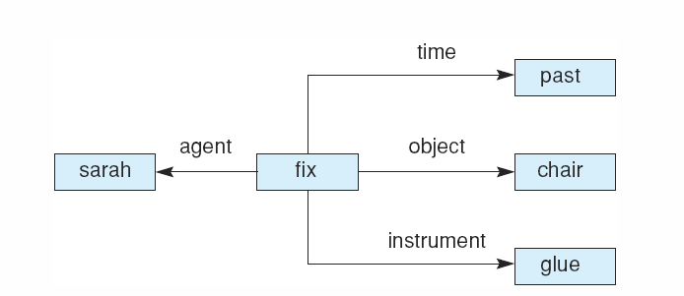
Case Frame
Verb-oriented approach
Links define the roles of nouns/phrases in the action of the sentence
Case relationships: agent, object, instrument, location, time, etc.
Case frame representation of the sentence “Sarah fixed the chair with glue.”
Artificial Intelligence

Slide 13
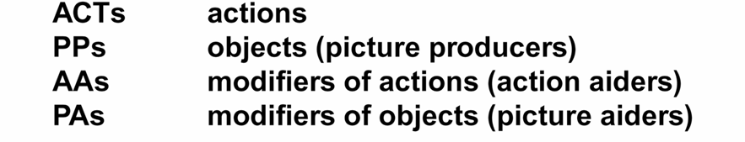
Conceptual Dependency
Schank’s theory
Offers a set of four equal and independent primitive conceptualizations
From the primitives the word of meaning is built
Artificial Intelligence

Slide 14
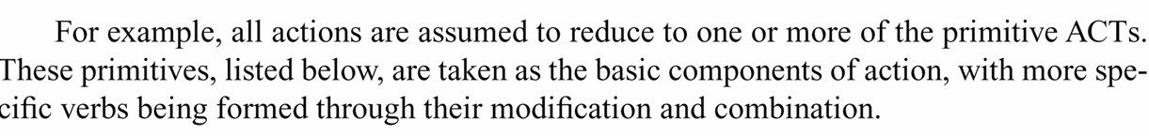
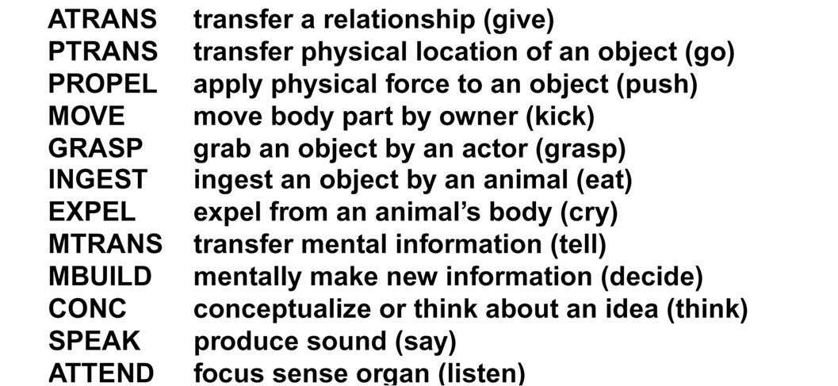
Conceptual dependency theory: An Example
Artificial Intelligence

Slide 15
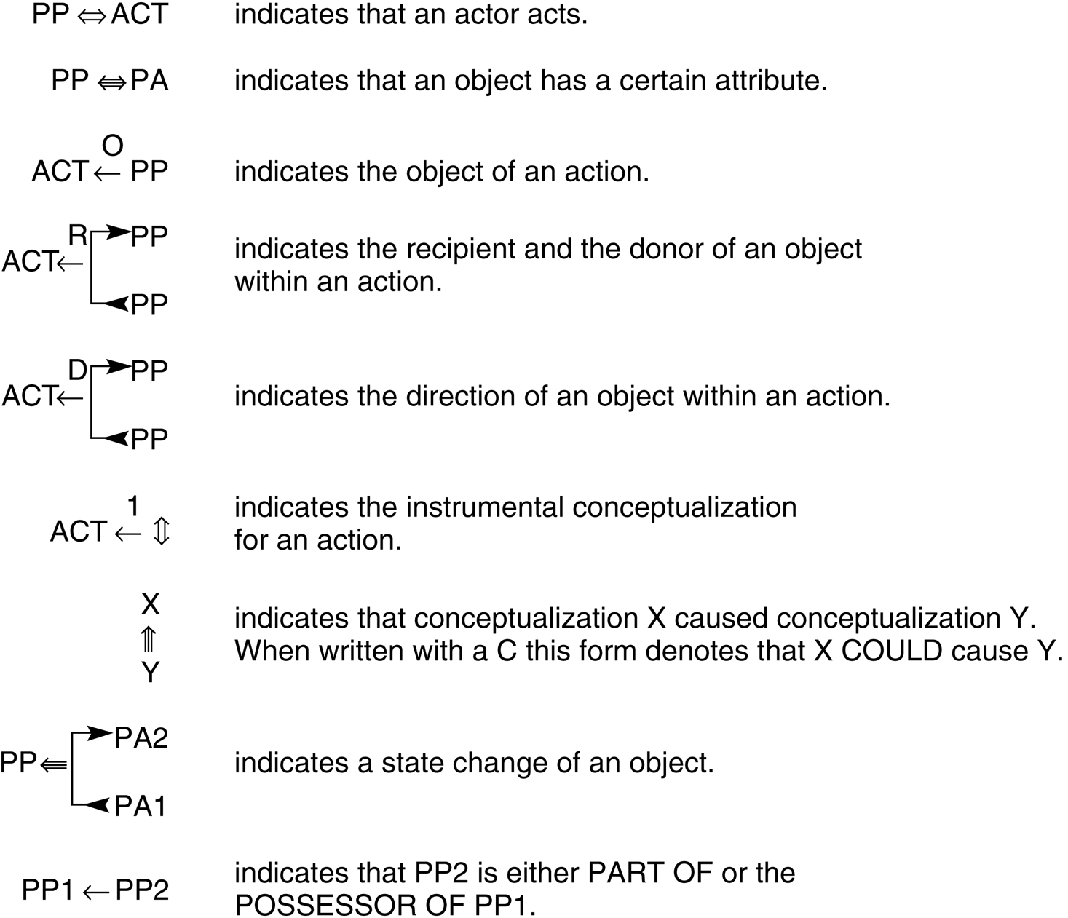
The primitives are used to define conceptual dependency relationships
Conceptual syntax rules
Artificial Intelligence

Slide 16
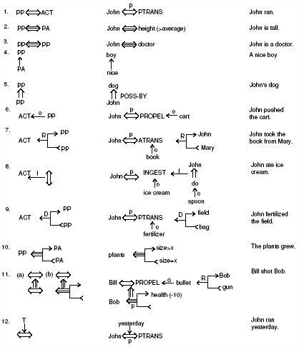
Some basic conceptual dependencies and their use in representing more complex English sentences
Artificial Intelligence

Slide 17
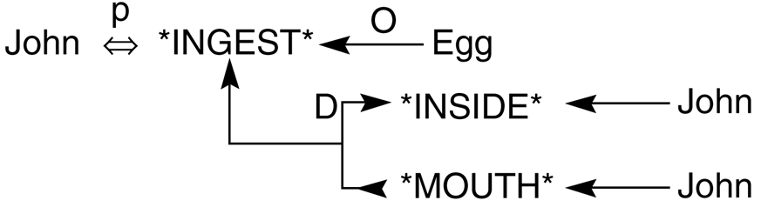
Conceptual dependency representing “John ate the egg”
← the direction of dependency
⬅➔ The agent-verb relationship
P past tense
INGEST a primitive act of the theory
O object relation
D the direction of the object in the action
Artificial Intelligence

Slide 18
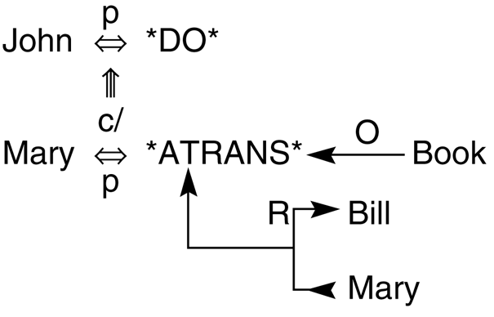
Conceptual dependency representation of the sentence “John prevented Mary from giving a book to Bill”
More tenses and modes
p past
f future
t transition
k continuing
c conditional
/ negative
? Interrogative
pil present
Artificial Intelligence

Slide 19
Scripts
Designed by Schank in 1974
A structured representation describing a stereotyped sequence of events in a particular context
A means of organizing conceptual dependency structures
Used in natural language understanding for knowledge base
Artificial Intelligence

Slide 20
Script Components
Entry conditions or descriptors of the world that must be true for the script to be called.
Results or facts that are true once the script has terminated.
Props or the “things” that support the content of the script.
Roles are actions that the individual participants perform
Scenes are a sequence of what represents a temporal aspect of the script.
Artificial Intelligence

Slide 21
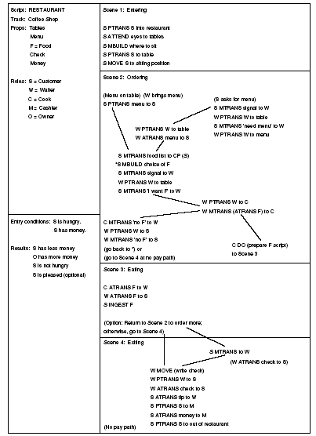
A Restaurant Script
Artificial Intelligence

Slide 22
Frames
Capture the implicit connections of information from the explicitly organized data structure
Support the organization of knowledge into more complex units
Similar to classes in Object-oriented
Proposed by Minsky in 1975
  Here is the essence of the frame theory: When one encounters a new situation (or makes a substantial change in one’s view of a problem) one selects from memory a structure called a “frame”. This is a remembered framework to be adapted to fit reality by changing details as necessary.
Artificial Intelligence

Slide 23
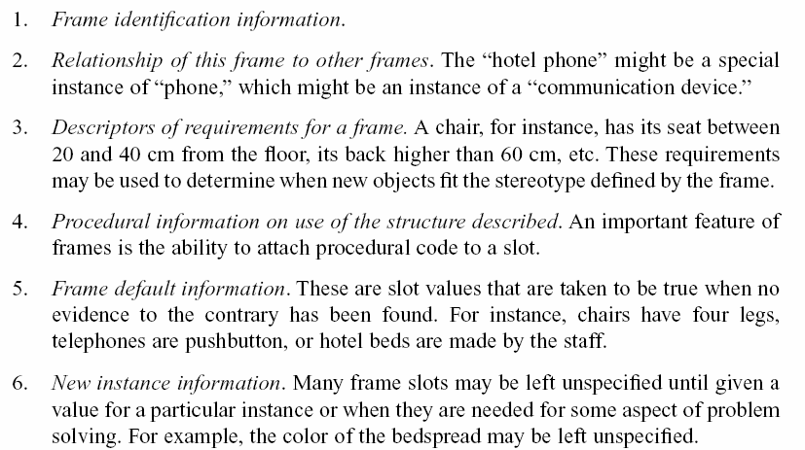
Frame Slots
A frame is a set of slots (similar to a set of fields in a class in OO)
The slots may contain the following information
Artificial Intelligence

Slide 24
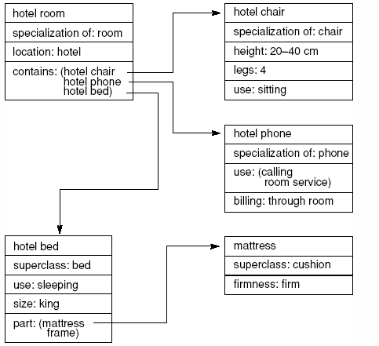
Frame: An Example
Part of a frame description of a hotel room.
“Specialization” indicates a pointer to a superclass
Artificial Intelligence

Slide 25
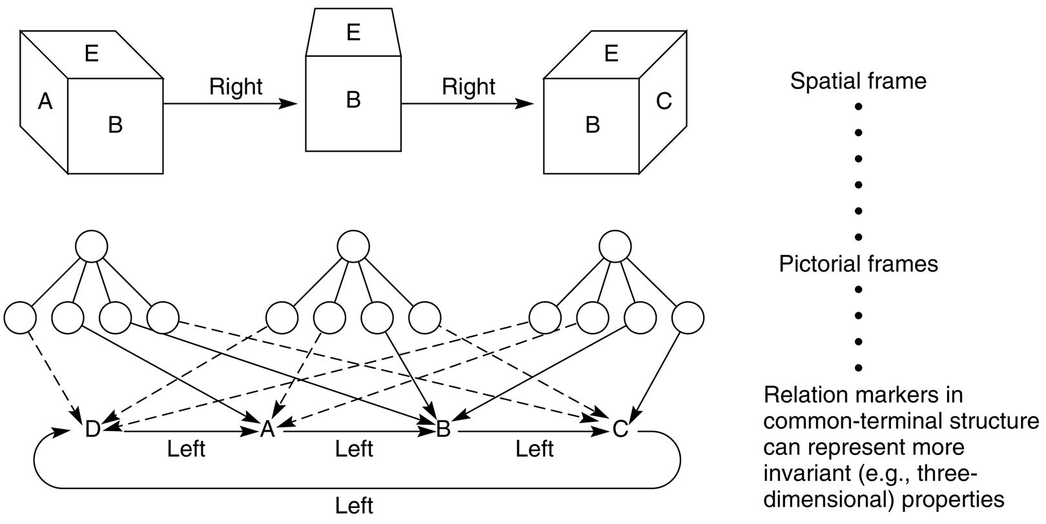
Spatial frame for viewing a cube
Artificial Intelligence

Slide 26
Conceptual Graphs
Conceptual graph
  A finite, connected, bipartite graph
  No arc labels
  Nodes
    concept nodes – box nodes
      Concrete concepts: cat, telephone, classroom
      Abstract objects: love, beauty, loyalty
    conceptual relation nodes – ellipse nodes
      Relations involving one or more concepts
      Arity – number of box nodes linked to
Artificial Intelligence

Slide 27
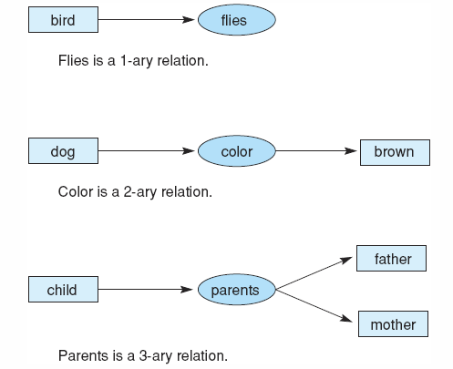
Conceptual relations of different arities
Artificial Intelligence

Slide 28
Types, Individual, and Names
Type
  A class, a concept
  Types are organized into hierarchy
Individual -- Concrete entity
Name – Identifier of type and individual
Conceptual Graph
  Concept box with type label indicating the class or type of individual represented by a node
  Label consists of type, :, and individual
  Unnamed individual labeled as marker: #<number>
  Marker can separate an individual from name
Artificial Intelligence

Slide 29
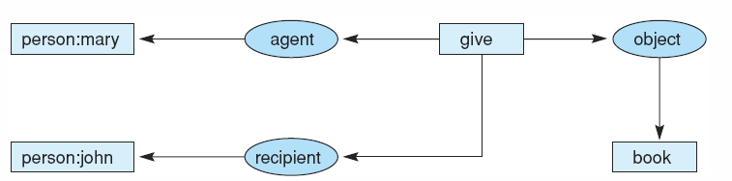
Graph of “Mary gave John the book”
Artificial Intelligence

Slide 30
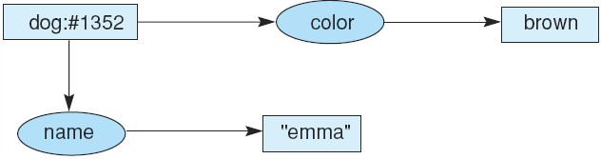
Conceptual graph indicating that the dog named Emma is brown.
Conceptual graph indicating that a particular (but unnamed) dog is brown.
Conceptual graph indicating that a dog named Emma is brown.
Artificial Intelligence

Slide 31
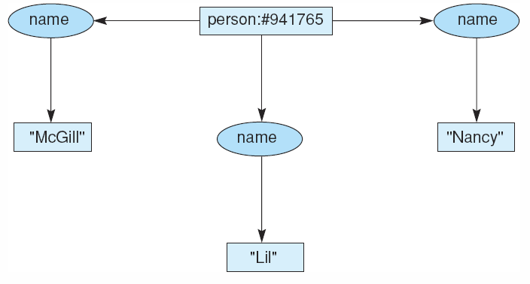
Conceptual graph of a person with three names
Artificial Intelligence

Slide 32
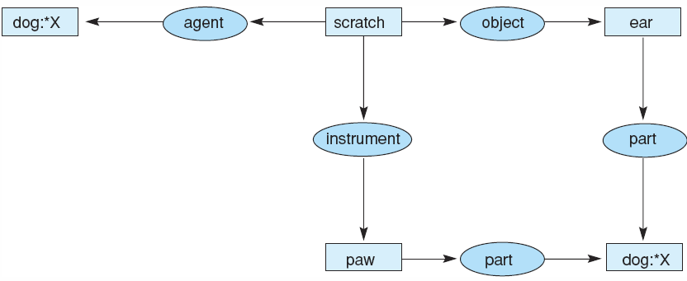
Conceptual graph of the sentence “The dog scratches its ear with its paw.”
Artificial Intelligence

Slide 33
The Type Hierarchy
A partial ordering of types: ≤
Represent inheritance relationship between types (sub-super)
Type hierarchy forms a lattice
Common subtype
  If s, t and u are types, with t≤s and t≤u, then t is a common subtype of s and u
  Maximum common subtype: if t is a common subtype of s and u, and for any common subtype w of s and u, t≤w
Common supertype
  If s, t and u are types, with s≤t and u≤t, then t is a common supertype of s and u
  Minimum common supertype: if t is a common supertype of s and u, and for any common supertype w of s and u, w≤t.
Artificial Intelligence

Slide 34
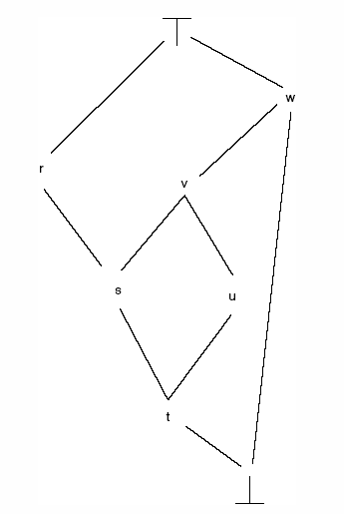
A type lattice illustrating subtypes, supertypes, the universal type, and the absurd type. Arcs represent the relationship.
Artificial Intelligence

Slide 35
Generalization and Specification
Generalizing and specializing graphs
Operations to create new graphs from existing graphs:
  Copy: for a new graph exactly copied
  Restrict: replace nodes by a node representing their specification
    Replace generic marker by individual marker
    Replace a type by its subtype
  Join: combine two graphs into a single graph
    This is a special restriction
  Simplify: delete duplicate relations
Artificial Intelligence

Slide 36
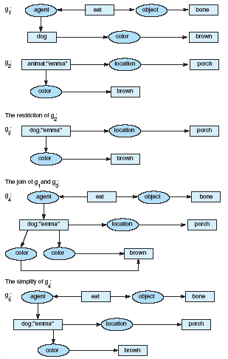
Examples of restrict, join, and simplify operations
Artificial Intelligence

Slide 37
Inheritance: Join and Restrict
Inheritance can be implemented as join and restrict
  Replace a generic marker by an individual: implement the inheritance of properties of a type by individual
  Replace a type by a subtype: implement inheritance between a type and subtype
  Join one graph to another and then restrict certain nodes: implement inheritance of various properties
Artificial Intelligence

Slide 38
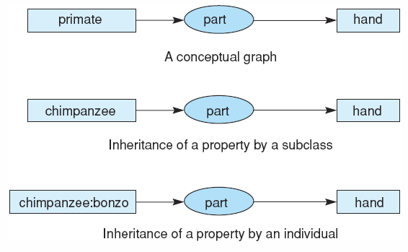
Inheritance in conceptual graphs
Artificial Intelligence

Slide 39
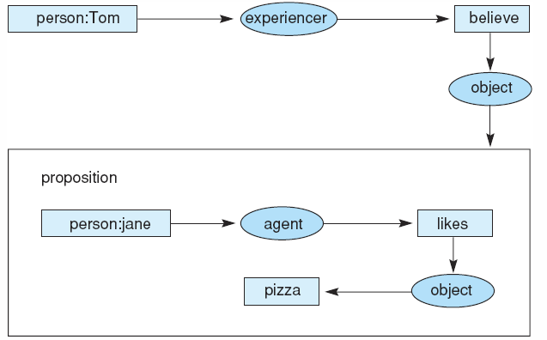
Propositional Nodes
Relations between propositions
Proposition -- A concept type
Propositional concept node contains another conceptual graph
Conceptual graph of the statement “Tom believes that Jane likes pizza,” showing the use of a propositional concept.
Artificial Intelligence

Slide 40
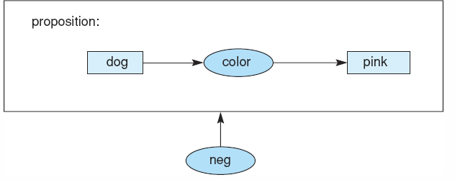
Conceptual Graphs and Logic
Can represent conjunctive concepts
Negation – propositional concept an a unary operation: neg
Disjunctive – converted to conjunctive and negation
Conceptual graph of the proposition “There are no pink dogs.”
Artificial Intelligence

